Slide 1
Please read
This presentation template uses the CiscoSans TT ExtraLight font. If the text in these two columns does not match, please take a moment to install the font. Otherwise, your presentation will not display correctly.
Please download the fonts from Brand Exchange here. The font can also be found in the zipped folder. Double-click the font file and click “Install” in the window that appears.
This presentation template uses the CiscoSans TT ExtraLight font. If the text in these two columns does not match, please take a moment to install the font. Otherwise, your presentation will not display correctly.
Please download the fonts from Brand Exchange here. The font can also be found in the zipped folder. Double-click the font file and click “Install” in the window that appears.

Slide 2
Presentation Title Goes Here
Subtitle goes here
Speaker name
Speaker title

Slide 3
Presentation Title Goes Here
Subtitle Goes Here
Speaker Name
Speaker Title
Date

Slide 4
Agenda
First topic
Second topic
Third topic

Slide 5
Use this slide for transitions

Slide 6
Use this slide for transitions

Slide 7
Use this slide for transitions

Slide 8
“Design is the silent ambassador of your brand.”
Paul Rand

Slide 9
“Design is the silent ambassador of your brand.”
Paul Rand

Slide 10
This is a sample headline
This is the standard bullet slide
Keep bullet points brief
Adjust font sizes as needed to fill the space
Use line spacing to clearly separate each point
Use the two-column layout for text-heavy slides

Slide 11
This is a sample headline
Instead of bullet points, you can use a few words here if needed.
Keep sentences short and use no more than three.
Audiences should be able to take them in at a glance.

Slide 12
This is a sample headline
Secondary information goes here
Keep bullets brief
Use line spacing to clearly separate each point
Use the two-column layout for text-heavy slides
Put your main point here. Use this space for a brief paragraph – no more than two or three sentences. Font size should be around 24 pt.

Slide 13
Two-column layout
Use this layout when you have to show six or more bullets
Text size should be approximately 20 pt
Use paragraph spacing to clearly separate each point
Use bold or italic text sparingly
Use this layout when you have to show six or more bullets
Text size should be approximately 20 pt
Use paragraph spacing to clearly separate each point
Use bold or italic text sparingly

Slide 14
This is a sample headline

Slide 15
This is a sample headline

Slide 16
This is a sample headline

Slide 17
Bar charts
Enter source information here

Slide 18
Line charts
Enter source information here

Slide 19
This is a sample headline
Heading 1 | Heading 2 | Heading 3
100 | 100 | 100
100 | 100 | 100
100 | 100 | 100
100 | 100 | 100
100 | 100 | 100

Slide 20
Slide title
Heading 1 | Heading 2 | Heading 3
100 | 100 | 100
100 | 100 | 100
100 | 100 | 100
100 | 100 | 100
100 | 100 | 100
100 | 100 | 100
Enter source information here

Slide 21
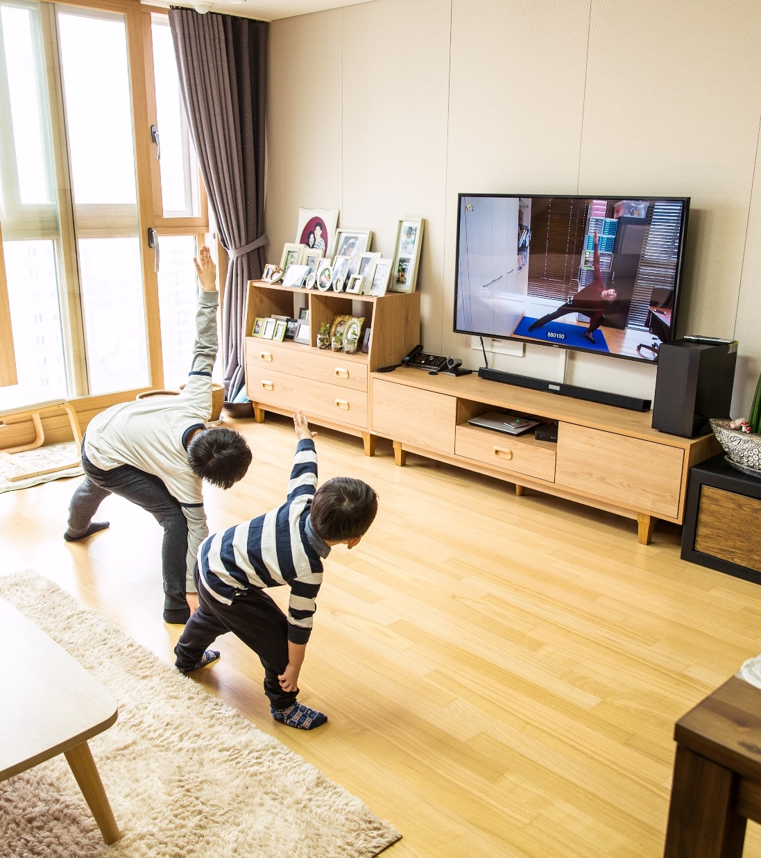
Use this layout when pairing words with a picture.

Slide 22

Use this layout when pairing words with a picture.
Use this space to provide details if needed.

Slide 23
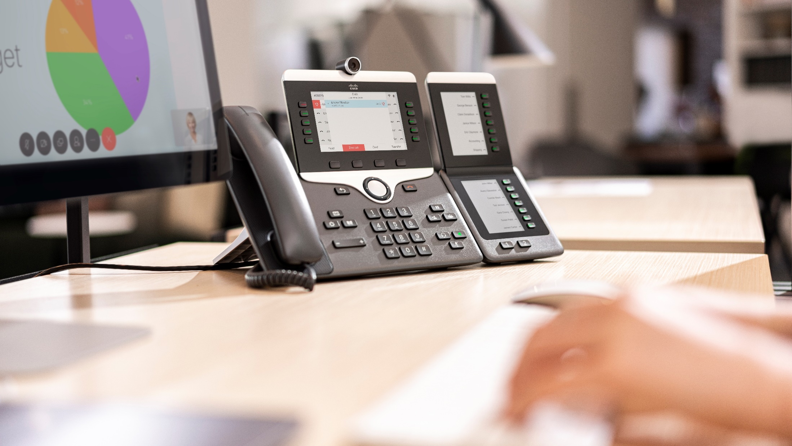
Use this space to provide a bit of detail.

Slide 24
Best practices

Slide 25
Color palette
Hero
Secondary
Use the hero palette colors as much as possible.
Accent colors should only be used to call attention to important details, such as in a chart.
Sky Blue
R 0
G 188
B 235
Midnight Blue
R 13
G 39
B 77
Ocean Blue*
R 30
G 68
B 113
Green
R 116
G 191
B 75
Accent
Exceptions
Orange
R 251
G 171
B 44
Red
R 227
G 36
B 27
Cisco Blue** (Tint)
R 180
G 226
B 246
*used in the default template only for text and charts
** used in the dark template only for charts

Slide 26
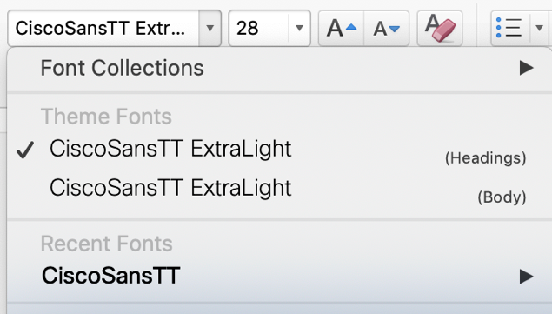
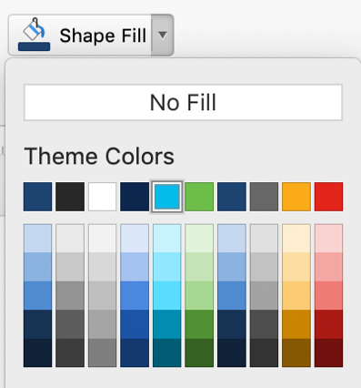
Only use the themes provided
Always use the template themes. It ensures consistency and reduces editing time when you share content between presentations.
Theme fonts
PowerPoint provides two theme fonts – for headings and body. They are found at the top of the font menu.
Do not select fonts from the “All Fonts” section of the list.
Theme colors
Our brand colors are included in the theme color section. Use only these colors and associated tints/shadows.
Do not use Standard Colors or create custom colors.

Slide 27
Mobile Demo
Place your screenshot here
This is a sample feature

Slide 28
Tablet Demo
Place your screenshot here
This is a sample feature

Slide 29
Desktop Demo
Place your screenshot here
This is a sample feature

Slide 30
Seven tips for better presentations
Tell a story—make them care
Start with what’s most important to them
Keep it simple, and short
Use more slides with less on them, and cut any slides that you can
Use clear, natural language
Make it a conversation and leave time to listen
Tell them what to do next—get them to act

